Slide 1

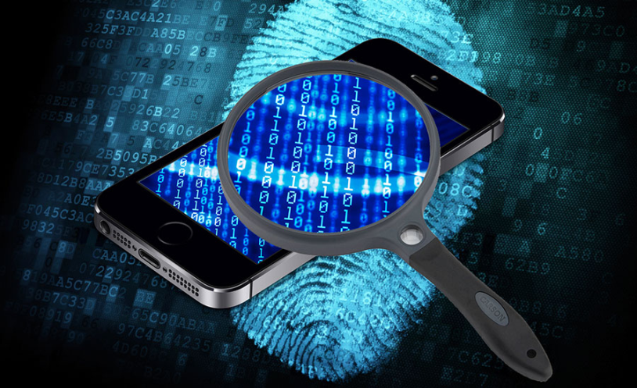
Mobile Phone Security
Dr. Digvijaysinh Rathod
Associate Professor
(Cyber Security and Digital Forensics)
National Forensic Sciences University with status of Institution of National Importance
digvijay.rathod@gfsu.edu.in

Slide 2
Request
Interception
using BurpSuit
Dr. Digvijaysinh Rathod

Slide 3
Web Application Request and Response
Web Application
Web Browser
Web Server
Database
Dr. Digvijaysinh Rathod

Slide 4
Web Application with Proxy
Web Application
Edit Request
Forward
Proxy
Web Browser
Web Server
Database
Dr. Digvijaysinh Rathod

Slide 5
Mobile Application Request and Response
2
Windows Server
/ Linux Server
1
Mobile Phone
Web Services
Web Server
Mobile Application
Application Framework
Database
Web Application
Database Engine
Third Party API
Dr. Digvijaysinh Rathod

Slide 6
Mobile Application with Proxy
Edit Request
Forward
Proxy
2
Windows Server
/ Linux Server
1
Mobile Phone
Web Services
Web Server
Z
Z
Application Framework
Mobile Application
Web Application
Database
Database Engine
Third Party API
Dr. Digvijaysinh Rathod

Slide 7
Mobile Application – Burp Suite
Interception of request
Santoku
Windows machine
Dr. Digvijaysinh Rathod

